Slide 1

Machine Learning Algorithms (Naïve Bayes)
Md. Abu Naser Mojumder

Slide 2
Well known Machine Learning Algorithms
Supervised Learning
Unsupervised Learning
Reinforcement Learning
Regression
Simple Linear Regression
Multiple Linear Regression
Polynomial Regression
Clustering
K-Means Clustering
Hierarchical Clustering
Upper Confidence Bound(UCB)
Thomson Sampling
Classification
Logistic Regression
k-Nearest Neighbors(k-NN)
Support Vector Machine(SVM)
Naïve Bayes
Decision Tree Classification
Random Forest Classification
Dimensionality Reduction
Principal Component Analysis(PCA)
Linear Discriminant Analysis (LDA)
Deep Learning Algorithm
Artificial Neural Network(ANN)
Convolutional Neural Network(CNN)

Slide 3

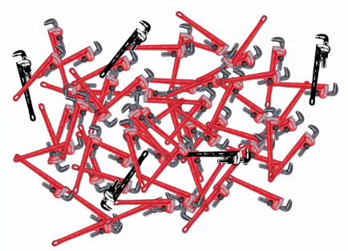
Naïve Bayes
Bayes Theorem
M1
M2
Defective Spanner
Good Spanner
What is the probability of a random wrenches that comes from a specific machine is defective?

Slide 4
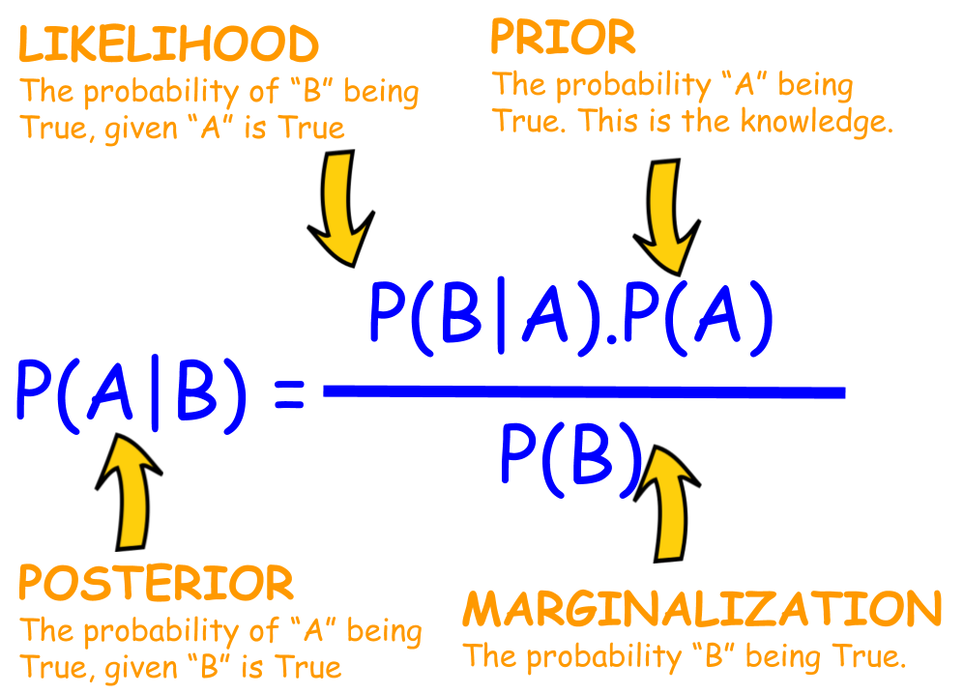
Naïve Bayes
Bayes Theorem
Bayes' Theorem is a way of finding a probability when we know certain other probabilities.
The formula is:

Slide 5
Naïve Bayes
Bayes Theorem
Mach1: 30 wrenches/hr
Mach2: 20 wrenches/hr
Out of all produced parts:
We can see that 1% are defective
Out of all defective parts:
We can see that 50% came from mach1
And 50% came from mach2
Question:
What is the probability that a part produced by mach2 is defective = ?
P(Mach1) = 30/50 = 0.6
P(Mach2) = 20/50 = 0.4
P(defect) = 1%
P(Mach1 | Defect) = 50%
P(Mach2 | Defect) = 50%
P(Defect | Mach2) = ?

Slide 6
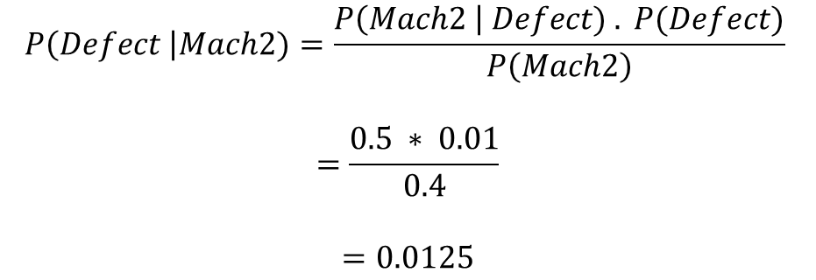
Naïve Bayes
Bayes Theorem
Question:
What is the probability that a part produced by mach2 is defective = ?
Solution:
Mach1: 30 wrenches/hr
Mach2: 20 wrenches/hr
Out of all produced parts:
We can see that 1% are defective
Out of all defective parts:
We can see that 50% came from mach1
And 50% came from mach2
$$P\left(Defect \right|Mach2)=\frac{P\left(Mach2 \right| Defect) . P(Defect)}{P\left(Mach2\right)}$$
$$=\frac{0.5 ∗ 0.01}{0.4}$$
$$=0.0125$$
P(Mach2) = 20/50 = 0.4
P(defect) = 1%
P(Mach2 | Defect) = 50%
P(Defect | Mach2) = ?
H.W. : Find $P\left(Defect \right|Mach1)$

Slide 7
Naïve Bayes
Naïve Bayes Classifier
Naïve Bayes algorithm is a supervised learning algorithm, which is based on Bayes theorem and used for solving classification problems.
Naïve Bayes Classifier is one of the simple and most effective Classification algorithms which helps in building the fast machine learning models that can make quick predictions.
It is a probabilistic classifier, which means it predicts on the basis of the probability of an object.
Some popular examples of Naïve Bayes Algorithm are spam filtration, Sentimental analysis, and classifying articles.

Slide 8
Naïve Bayes
Why is it called Naïve Bayes?
The Naïve Bayes algorithm is comprised of two words Naïve and Bayes, Which can be described as:
Naïve: It is called Naïve because it assumes that the occurrence of a certain feature is independent of the occurrence of other features. Such as if the fruit is identified on the bases of color, shape, and taste, then red, spherical, and sweet fruit is recognized as an apple. Hence each feature individually contributes to identify that it is an apple without depending on each other.
Bayes: It is called Bayes because it depends on the principle of Bayes' Theorem.

Slide 9
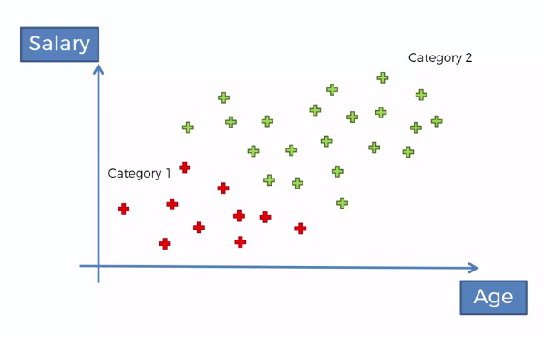
Naïve Bayes
Naïve Bayes Classifier
Drives
Walks
New datapoint
Is the person going to classifies as a person who walks to work or who drives to work?

Slide 10
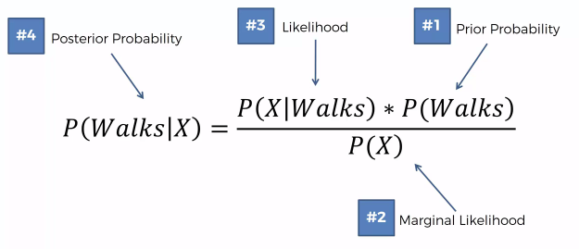


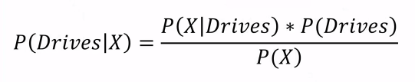
Naïve Bayes
Naïve Bayes Classifier
X = Features
In this example, we have two features: Salary and Age
We need to calculate
and
Which means,
Probability of a person walks to work having a given set of features(X), and,
Probability of a person walks to work having a given set of features(X)
Lets say, a person have features:
Age = 32 and Salary = $24k,
We want to predict, is that person walks to work or drives to work?

Slide 11
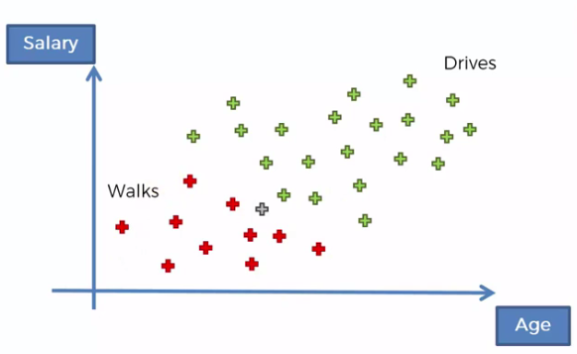
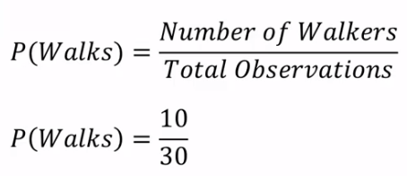
Naïve Bayes
Naïve Bayes Classifier
In this case, we have total 30 observations.

Slide 12
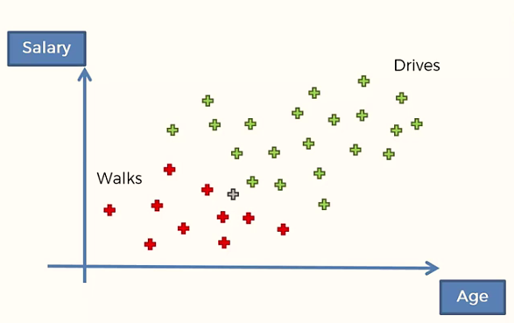


Naïve Bayes
Naïve Bayes Classifier
Calculating P(X)
We need to select a radius and draw a circle around our observations.
This radius parameter is selected randomly, you can take any value as an input parameter.
All the observations inside this circle are considered as similar in terms of features.
P(x) is the probability of a new datapoint that we add to the dataset being similar in features i.e., fall into this circle.

Slide 13
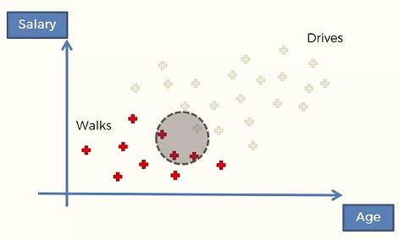
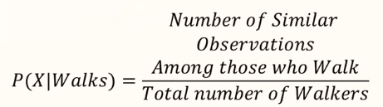

Naïve Bayes
Naïve Bayes Classifier
Calculating P(X|Drives)

Slide 14


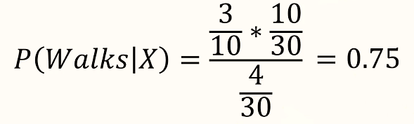
Naïve Bayes
Naïve Bayes Classifier
Now we have,

Slide 15
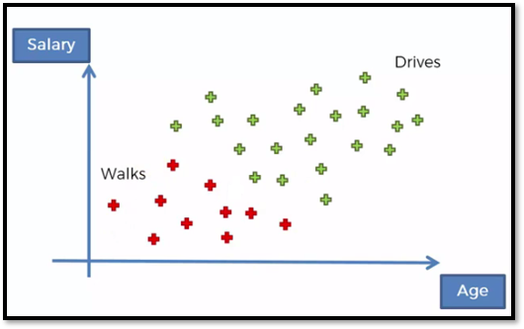
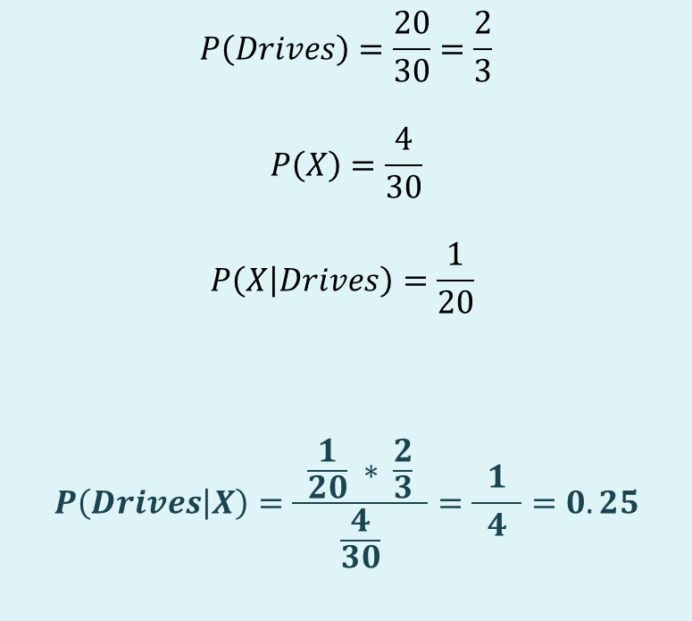
Naïve Bayes
Naïve Bayes Classifier
$$P\left(Drives\right)=\frac{20}{30}=\frac{2}{3}$$
$$P\left(X\right)=\frac{4}{30}$$
$$P\left(X | Drives\right)=\frac{1}{20}$$
$$P\left(Drives | X\right)=\frac{ \frac{1}{20} ∗ \frac{2}{3} }{\frac{4}{30}}=\frac{ 1 }{4}=0.25$$

Slide 16



Naïve Bayes
Naïve Bayes Classifier

Slide 17
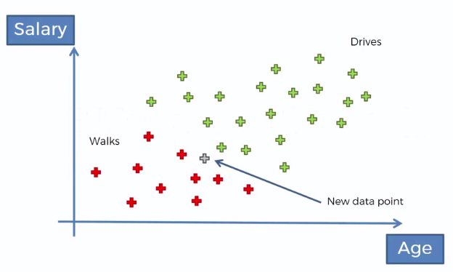
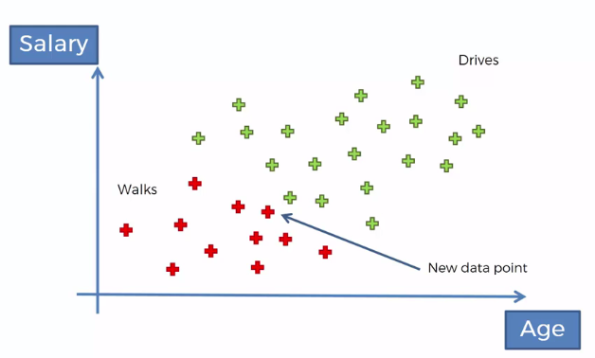
Naïve Bayes
Naïve Bayes Classifier

Slide 18


Naïve Bayes
Naïve Bayes Classifier
Problem: If the weather is sunny, then the Player should play or not?
Solution: To solve this, first consider the below dataset:
Count | Outlook | Play
0 | Rainy | Yes
1 | Sunny | Yes
2 | Overcast | Yes
3 | Overcast | Yes
4 | Sunny | No
5 | Rainy | Yes
6 | Sunny | Yes
7 | Overcast | Yes
8 | Rainy | No
9 | Sunny | No
10 | Sunny | Yes
11 | Rainy | No
12 | Overcast | Yes
13 | Overcast | Yes
We will calculate the followings:
$$P\left(Yes | Sunny\right)=\frac{P\left(Sunny | Yes\right)∗P(Yes)}{P\left(Sunny\right)}$$
$$P\left(No | Sunny\right)=\frac{P\left(Sunny | No\right)∗P(No)}{P\left(Sunny\right)}$$

Slide 19
Naïve Bayes
Naïve Bayes Classifier
Problem: If the weather is sunny, then the Player should play or not?
Solution: To solve this, first consider the below dataset:
Count | Outlook | Play
0 | Rainy | Yes
1 | Sunny | Yes
2 | Overcast | Yes
3 | Overcast | Yes
4 | Sunny | No
5 | Rainy | Yes
6 | Sunny | Yes
7 | Overcast | Yes
8 | Rainy | No
9 | Sunny | No
10 | Sunny | Yes
11 | Rainy | No
12 | Overcast | Yes
13 | Overcast | Yes
Frequency table for the Weather Conditions:
Likelihood table for
weather condition:
Weather | Yes | No
Overcast | 5 | 0
Rainy | 2 | 2
Sunny | 3 | 2
Total | 10 | 4
Weather | No | Yes
Overcast | 0 | 5 | 5/14= 0.35
Rainy | 2 | 2 | 4/14=0.29
Sunny | 2 | 3 | 5/14=0.35
All | 4/14=0.29 | 10/14=0.71

Slide 20
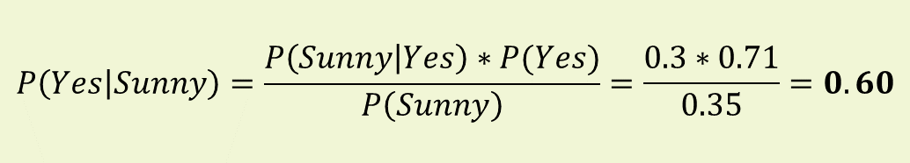
Naïve Bayes
Naïve Bayes Classifier
Frequency table for the Weather Conditions:
Likelihood table for
weather condition:
Weather | Yes | No
Overcast | 5 | 0
Rainy | 2 | 2
Sunny | 3 | 2
Total | 10 | 4
Weather | No | Yes
Overcast | 0 | 5 | 5/14= 0.35
Rainy | 2 | 2 | 4/14=0.29
Sunny | 2 | 3 | 5/14=0.35
All | 4/14=0.29 | 10/14=0.71
P(Sunny|Yes)= 3/10= 0.3
P(Sunny)= 0.35
P(Yes)=10/14=0.71
$$P\left(Yes | Sunny\right)=\frac{P\left(Sunny | Yes\right)∗P(Yes)}{P\left(Sunny\right)}=\frac{0.3∗0.71}{0.35}=0.60$$

Slide 21
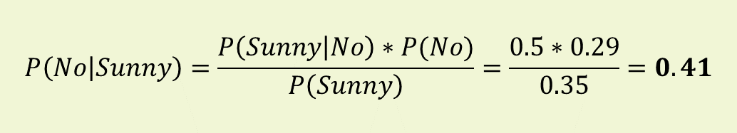
Naïve Bayes
Naïve Bayes Classifier
Frequency table for the Weather Conditions:
Likelihood table for
weather condition:
Weather | Yes | No
Overcast | 5 | 0
Rainy | 2 | 2
Sunny | 3 | 2
Total | 10 | 4
Weather | No | Yes
Overcast | 0 | 5 | 5/14= 0.35
Rainy | 2 | 2 | 4/14=0.29
Sunny | 2 | 3 | 5/14=0.35
All | 4/14=0.29 | 10/14=0.71
P(Sunny|No)= 2/4= 0.5
P(Sunny)= 0.35
P(No)=4/14=0.29
$$P\left(No | Sunny\right)=\frac{P\left(Sunny | No\right)∗P(No)}{P\left(Sunny\right)}=\frac{0.5∗0.29}{0.35}=0.41$$

Slide 22

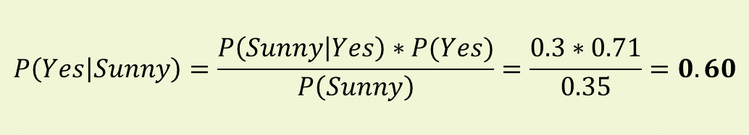

Naïve Bayes
Naïve Bayes Classifier
$$P\left(Yes | Sunny\right)=\frac{P\left(Sunny | Yes\right)∗P(Yes)}{P\left(Sunny\right)}=\frac{0.3∗0.71}{0.35}=0.60$$
$$P\left(No | Sunny\right)=\frac{P\left(Sunny | No\right)∗P(No)}{P\left(Sunny\right)}=\frac{0.5∗0.29}{0.35}=0.41$$
$$P\left(Yes | Sunny\right)>P\left(No | Sunny\right)$$
Hence on a Sunny day, Player can play the game.

